Slide 1

Opening a new vegan restaurant in Chicago
Presented by: Michael Basnar
February 2021

Slide 2
Introduction/Business Problem
There has been a slow shift in interests to a vegan lifestyle in the Chicago area.
The problem though is there seems to be a lack of vegan restaurants in the Chicago area.
Therefore to the right stakeholder it would prove beneficial to examine the city of Chicago's neighborhoods to ascertain the best possible locations for success and profitability.

Slide 3
Data Process
The data acquisition of the data will come from the Foursquare database
Data we will be looking for will be focused on where there are current vegan restaurants since those are areas have already shown a demand for the cuisine.
As the data process began it was very clear that there were very few vegan restaurants in Chicago…about 20

Slide 4
Methodology
Data acquisition from the Foursquare API
Data wrangling and cleaning
Data normalization if necessary
If necessary K-means clustering
Mapping and visualization of the data
Final analysis and conclusions

Slide 5
Methodology Continued
It was clear that K-means clustering was not necessary
1. There simply were too few data points to have any meaningful impact.
2. The mapped results made it plainly clear where vegan restaurants were in Chicago

Slide 6
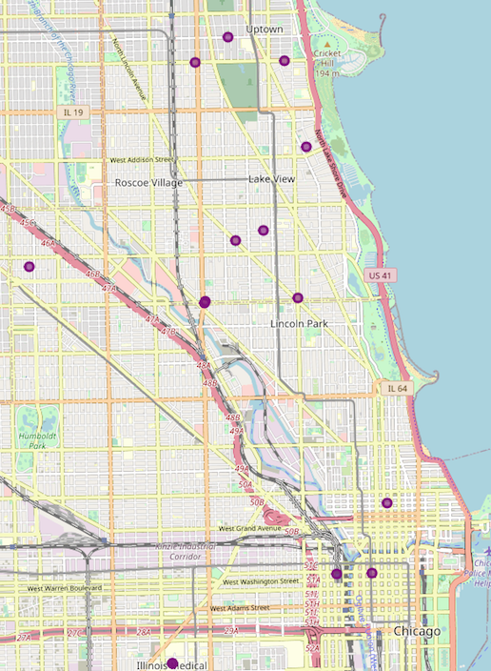
Mapped Results

Slide 7
Results
Final mapped results it is quite obvious
Uptown
Lakeview
Downtown (Loop)
Uptown or Lincoln Park would be ideal as they both have the highest concentration.

Slide 8
Discussion
Results were less than what was initially thought
Clearly a lack of vegan restaurants in Chicago
Finding another source for data
Demographics or possibly foot traffic

Slide 9
Conclusion
Further research may be necessary if other up in coming areas based on similar demographics are desired
Clear success in either the Uptown and Lincoln Park

